Slide 1

MemorAI
stories told by your loved one
Alice Hua, Ajit Barhate, Tim Chen
Notes:
Hello everyone. This is team MemorAI. MemorAI is a product where you can find stories told by your loved ones.

Slide 2
Agenda
Product
Pipeline, Models, Guardrails
Evaluation
Demo
Notes:
We will start by talking about the product. Then we will talk about the technical details behind product.
Lastly, we finish with a demo.

Slide 3
Product
Notes:
So let’s start with the product.

Slide 4

A son who travels the world to tell the story of his father...
Notes:
Nathaniel Kahn lost his father when he was a kid. Nathaniel wants to know the story of his father who is an architect. So Nathaniel travels the world, interviews friends and family of his father, so that he can put together a life story of his father.

Slide 5
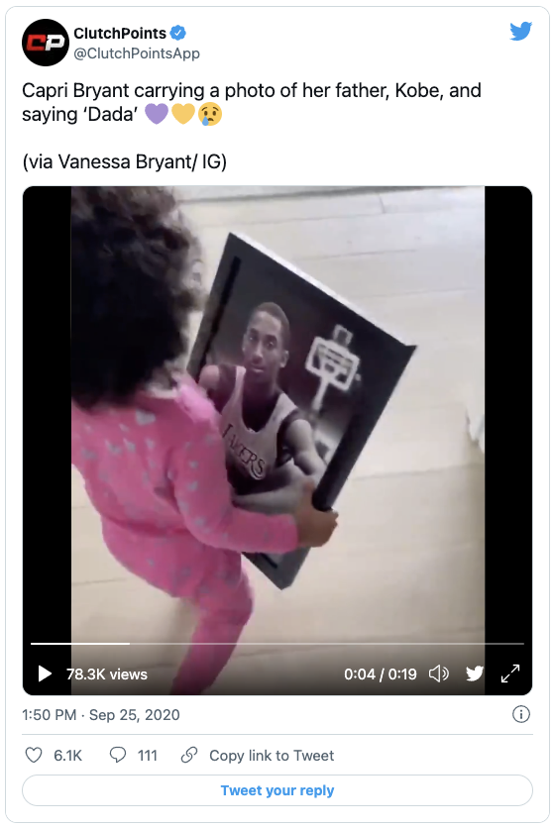
Notes:
Kobe Bryant, when he passed away, his youngest daughter Capri Bryant was only 2 years old. Capri, one day, will want to know the stories of his father.

Slide 6
The desire to know the stories of the lost loved ones...
Notes:
There is a common theme for the two stories: Nathaniel and Capri have, or will have, a desire to know the stories of their lost loved ones.
So this is our first use case. But this is only one side of the story.

Slide 7

A loving father. A passionate mountaineer.
Notes:
Conrad Anker is a very accomplished mountaineer. Whenever he leaves for an expedition, he always thinks about his two young children. He writes because he wants his children to know his stories in case he never returns.

Slide 8
A father who has been writing for his daughters.
Notes:
Even for me, a father of two young daughters, also has the fear that one day I might just pass away unexpectedly. And if that happens, my daughters would never have a chance to get to know me. So I have also been writing a blog for my daughters.

Slide 9
The desire to preserve my stories for the loved ones...
Notes:
So this is our second use case. Parents, especially for those with young children, have a desire to leave their stories for their loved ones.

Slide 10

Customer | Use Case
People who lost their parents at young age. | Desire to know the stories of the lost loved ones.
Early Parents with young kids. | Desire to leave stories for the loved ones.
Solution
MemorAi provides a platform where people can find stories told by their loved ones.
Notes:
So MemorAI provides the solution: It is a platform where you can find life stories told by your loved ones.

Slide 11
What Is MemorAI?
Language Model
First-Person Contents
Stories
Notes:
So on a very high level, MemorAI is is a language model.
The training set is first-person contents. “First-person” means, we only take contents from the person we are trying to capture. Not not a reporter, not a friend, not even a family member.
The outputs are stories.

Slide 12
Why not just ask friends and family?
Too much efforts! Life is complex. It takes efforts to put together the puzzles. Solution: MemorAI builds a language model put together the stories for you.
Not told by my loved one! Stories are told by others, but not your loved one. Solution: MemorAI ONLY collect stories told by your loved one.
Notes:
So you might ask: If you want to know your loved ones, why not just ask friends and family?
First of all, life is complex. Nathaniel, for example, took years to put together the story of his father. MemorAi helps by sourcing the available first-person contents for you.
Also, stories from friends and family are NOT told directly by your loved ones. And perspectives can get lost in translation.
MemorAI solves the problem because we ONLY collect stories told by your loved ones.

Slide 13
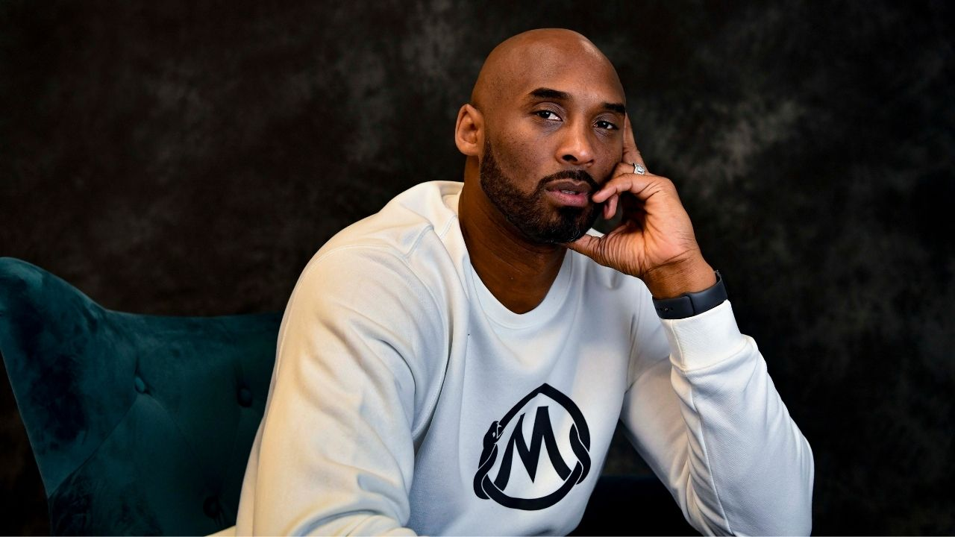
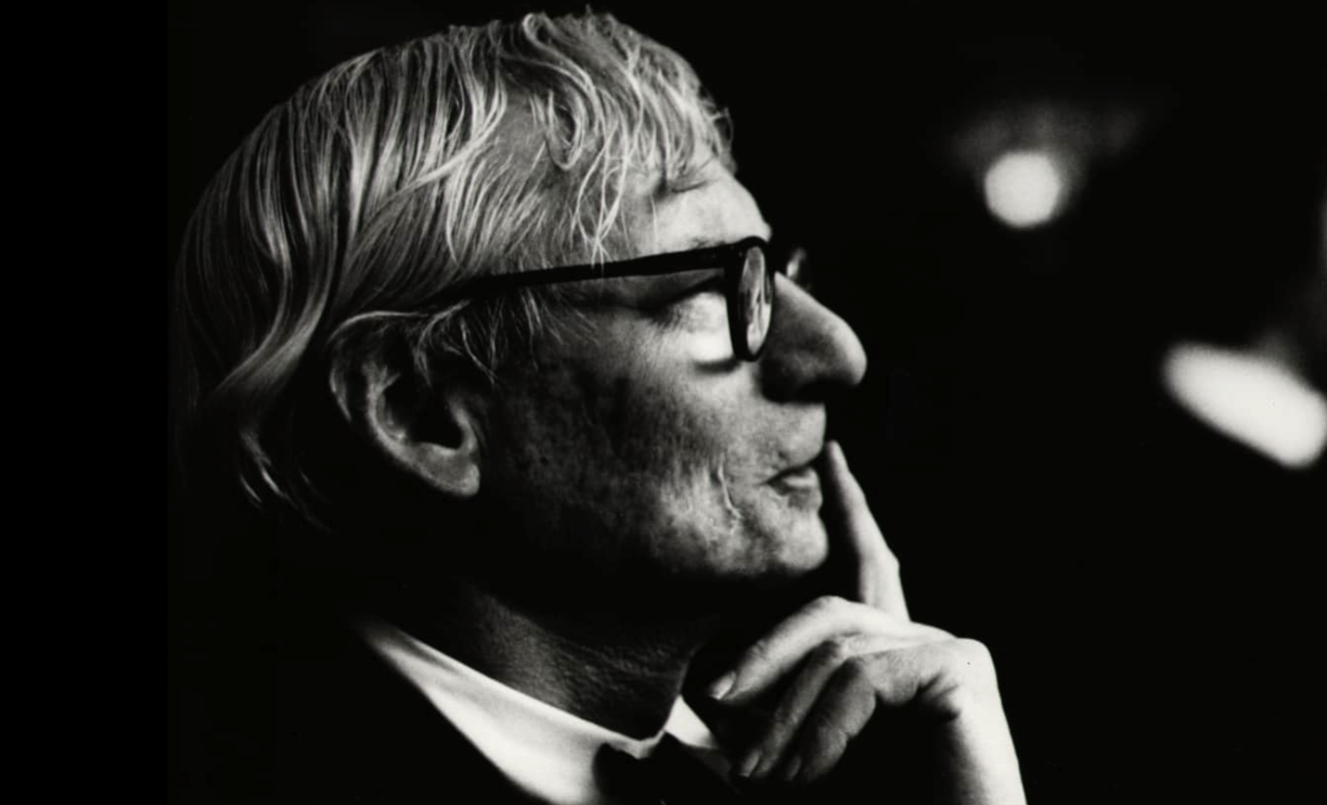
First-Person Contents Only
Our survey shows that 87.5% of respondents want to leave their life stories and philosophical views about life to their loved ones.
Public Figures E.g.Kobe Bryant, Conrad Anker, Luis Khan
Others E.g. Tim, Robert
Blogs
Books
Public Interviews
Speeches
MemorAI Interviews
Private Contents Diaries, Private Blogs, etc.
Notes:
So inputs to the model can be anything ranging from blogs, to books, to interviews, but we only take life stories told by the person we are trying to capture.

Slide 14


Data
Person | Data Source | Data size | Length of data
Alex Honnold Professional rock climber | Videos: Tedtalk (1), Youtube interviews (3). Book: Alone on the Wall Movie: Free Solo | 364KB | ~10hr11
Robert Louka Father | MemorAI Interviews (2.5) | 114KB | ~3hr18
Question: How much curated high-quality data (vetted by humans) is enough to emulate a person’s likeness?
Notes:
Alice:
I’m going to talk about our two different datasets, one of a public figure and one of our lovely classmate, a private citizen.
We estimated a total of 10 hours of Alex’s data in text for about 352KB, and about 2 hours for Robert’s data of 95KB.
OpenAI recommend having at least a couple hundred examples. In general, performance tends to linearly increase with every doubling of the number of examples.
Given how Alex’s fine-tuned model is performing, we can estimate how many interviews it would take for Robert’s model to perform just as well or better.
Extra info on how to estimate Alex’s book in hours:
Given reading 200words/min, at 71,233 words results in about 6 hrs worth of information

Slide 15
Pipeline & Models

Slide 16
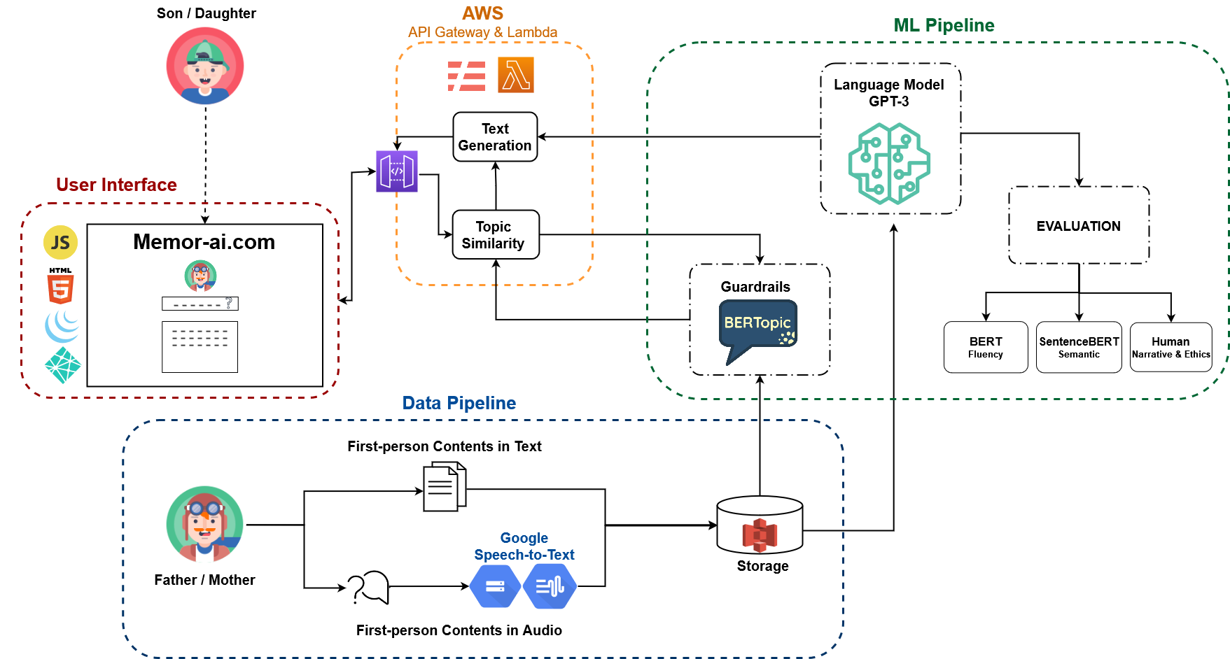
System Architecture
Notes:
Alice:
So now I’m going to talk about our system architecture. There are three main components: Data Pipeline, ML Pipeline and AWS infrastructure.
Starting with the loved one (father/mother), we collect their data in text and audio, audio is transcribed into text using Google Speech-to-text engine, the data is then stored.
It then gets fed into BERTopic for our guardrail system and GBT3, our language model.
The model output goes through our evaluation framework that we will go into details later.
On the other end, the user (their daughter or son) asks a question through our web application UI, the question goes through AWS API Gateway to trigger a lambda function which will evaluate whether the question has a similar topic as the training data.
Our trained BERTopic model gives a similarity score back. If the score is above our chosen threshold, we will let GBT3 generate text to response and display to the user.

Slide 17
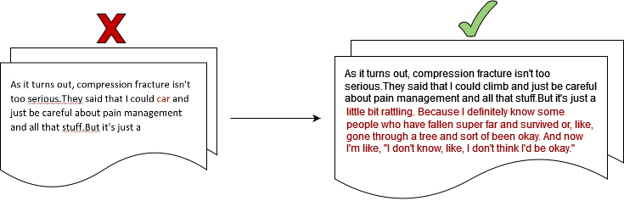
Data Collection and Processing
Scrape data for Alex
Interview Robert
Transcribe recordings
Remove incorrect punctuations, capitalizations, extra words
Replace incorrectly transcribed words, punctuations
Join sentences to ensure each complete thought
Notes:
Alice:
Here are the steps we took in processing the data: read those above
Challenge: We vetted our data for semantics, morphology, syntax, phonetics. We made sure that different style of speaking are transcribed accurately to reflect their actual spoken words and coherently articulating a person’s thought per training example.
Extra::
For example:
True - “my dad was one of two” vs Transcribe - “my dad was wanted to”
True - “we weren’t partiers by any means” vs Transcribe - “we weren’t part of yours by any means”

Slide 18
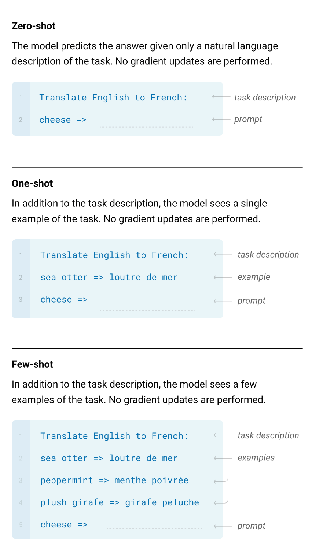
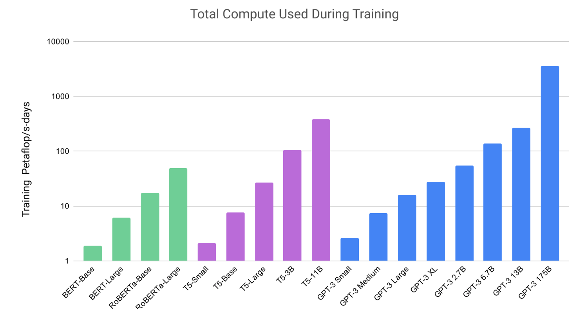
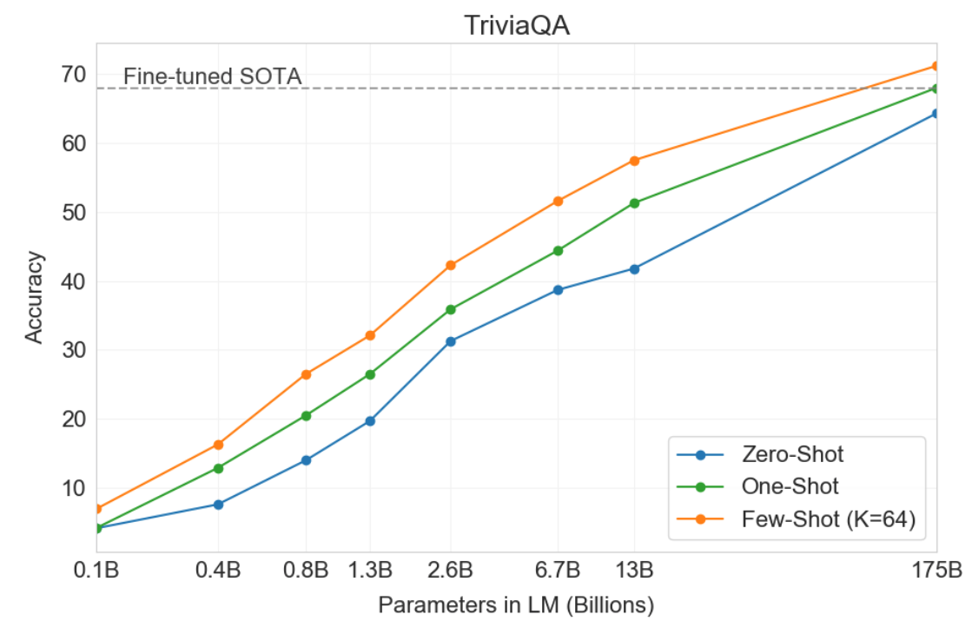
Language Model: GPT3
Notes:
Alice:
Here we chose to work with the Generative Pre-Trained Transformer 3rd version developed by OpenAI, currently only available on the private beta testing phase, and we’ve granted access thru an API
Similar to GPT2, GPT3 is a transformer and an autoregressive language model, it also has similar model architecture and predicts the next word in probabilistically. However, the main big difference is GPT3 is pre-trained on a massive dataset with 175 billion parameters whereas its predecessor GPT2 has 1.5 billion and smaller dataset.
You see that the graph on the top left showing the compute in petaflops as compared to BERT-based models and T5.
By definition, GPT3 is more performant than GPT2 on language-based tasks.
The model uses few-shot learning where its in-context learning involves showing many demonstrations as will fit into context window of 2048 instead of traditional fine-tuning on large datasets, there’s no gradient updates. This is possible because it has been pre-trained on a vast amount of data.
The bottom left graph is showing that as the model scales up, the performance between 3 different learning settings increase to the point of surpassing fined-tuned SOTA.
(for this Q&A task, the SOTA is a fine-tuned closed-book T5 and fine-tuned RAG open-domain)
Extra:
Some differences GPT2 (2019) vs GPT3 (2020)
They use the same architect with some modifications in the transformer layers.
GPT3 has 96 attention layers with 96 attention heads each layer, 128 dimensions each head, with 3.2M batch size.
However, GPT3 is more performant than GPT2 on language-based tasks including code generation, generate news articles, conservation, etc.
GPT3 is evaluated on over 2 dozens NLP datasets under 3 conditions/settings: few shot, one-shot and zero shot. One-shot and zero (one demonstration and no demonstration, only instruction in natural language is given)
These conditions involve no gradient updates as opposed to fine-tuning on each task with a dataset, here, gpt3 few shot works just as well by increasing numbers of demonstrations at inference time.

Slide 19
Fine-tuning & Hyperparameters
Guideline:
Open ended generation
Case study:
Maintaining a company voice
OpenAI API Limitations & Fine-tune
10 fine-tune runs per month, limit 80-100MB data
Prompt + completion ≤ 2048 tokens
Hyperparameters for fine-tuning:
n_epochs (limit:5): 5
batch_size (limit: 5): 5
learning rate multiplier (0.01-0.4): 0.05
prompt_loss_weight (0.1-1): 0.5
Completion Parameters
Engine: Davinci, Curie, Babbage, Ada
Response length (≤ 2048): 512
Temperature (0-1): 0.1
Frequency penalty (-2 - 2): 1
Presence penalty (-2 - 2):: 1
Stop sequences: [“ \###”]
Content filtering: sensitive, safe, unsafe
Notes:
Alice:
Now I’m going to talk about the three fine-tuning process components: Guideline, API limitation and Completion Parameters.
First, we looked at guidelines and use cases to understand what fits best for our product.
There are 3 guidelines: Classification, Conditional generation and Open ended generation, each guideline has several use cases. Here, we’ve picked open ended generation and its use cases: maintaining company voice. This allows the high-quality documents which are good examples of the company voice to be fed into the model so the output can follow the company voice. For our use case, the specific voice is the loved one’s voice. This technique is also used in creating a virtual character with a particular personality, style of speech and the topics the character talks about.
Next, we start to fine tune while keeping in mind a few OpenAI limitations such as allowing only 10 fine-tune runs/month, limits on dataset size, tokens, and parameters.
Fine-tuning improves on few-shot learning by training on many more examples. Once the model is fine-tuned, there’s no need to provide examples during inference.
We selected the values of hyperparameters based on the recommendation for a smaller dataset and our open ended generation use case.
Finally, our Completion Parameters are picked to as appropriate for our use case.
Model: there are 4 models ranging from the most capable to the fastest. Davinci is most capable, it can perform any tasks that other models can and suitable for our application where a lot of understanding of the content is needed. However, OpenAI told us that it may be available in Dec
Temperature and Top P control the randomness or creativity in completion. Lower temp means completion is more deterministic, completion vary each time something is asked (unless they’re exact wording in the train set).
Frequency penalty: decreases the model’s likelihood of repeating the same line verbatim
Presence penalty: increases the model’s likelihood of talking about new topics
Content filtering: helps to evaluate the text that GPT-3 generates. We feed the output of GPT-3 back to GPT-3 filter engine to do the classification of whether the text is sensitive, safe or unsafe. If a content is sensitive or unsafe, a new completion is generated and sent without the user knowing that some content was blocked. Our goal is to recognizes unintentional but potentially offensive or harmful language and only return safe content. The caveat is this might affect your application where there are many false positives. We have seen that some content with topic including politics or religion usually get flagged. So this is something we can continue to explore with a threshold as well.
Extra: Because the model is not conscious, there it does not have a will to say harmful things, it just generate text based on a statistical probability, but being trained on internet-scale data it will have internet-scale biase
Temperature: setting to keep the API more focused on the intent of the prompt or increase it to let it go off on a tangent. Lower is more focus, higher is more creative
Top P controls how many tokens are considered during completion.

Slide 20
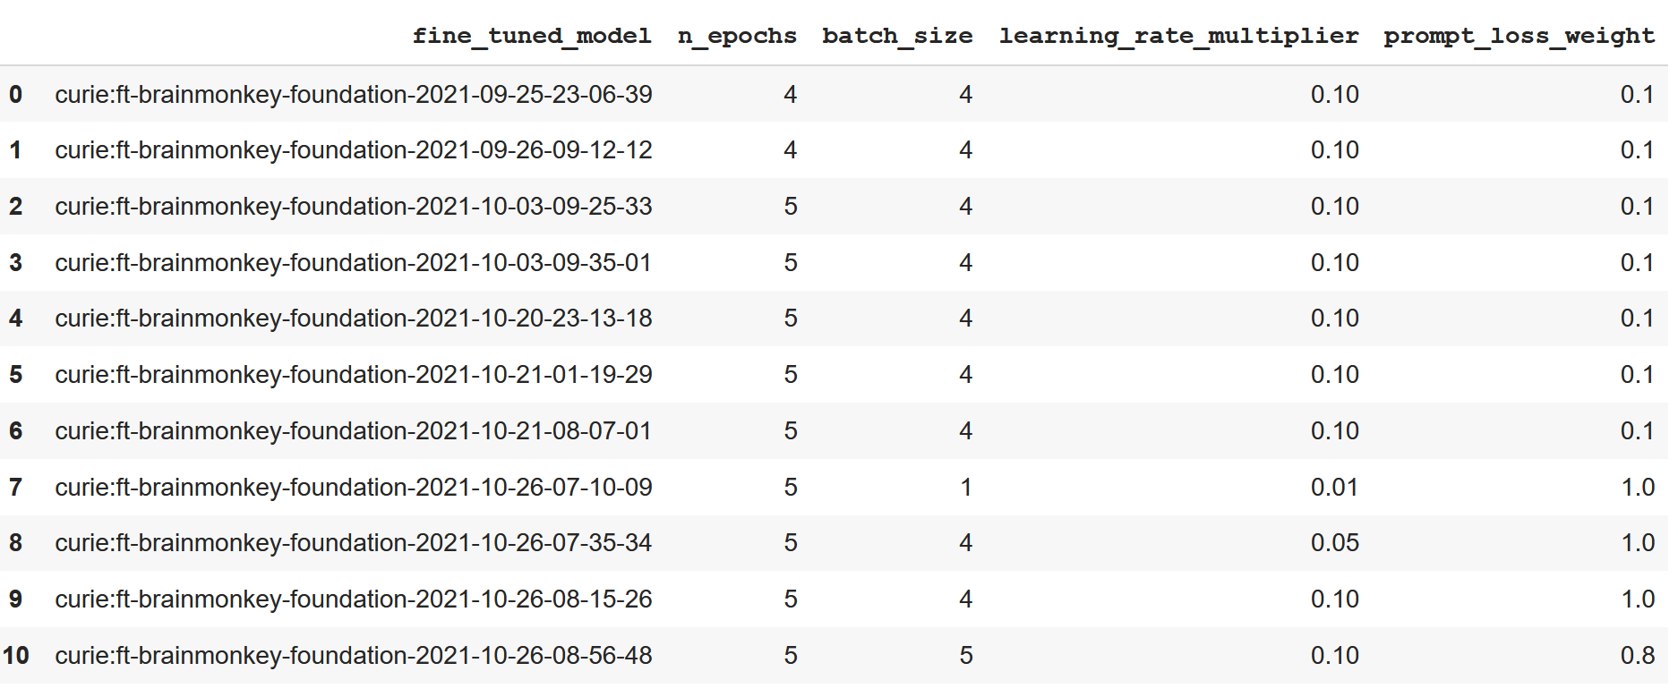
Fine-tuning & Hyperparameters cont.
Notes:
Alice: The goal is to have close to a grid search, with completion params and evaluation metric all logged for each run and visualize them
Obviously with the limitation of number of epochs in mind,

Slide 21
Guardrails

Slide 22
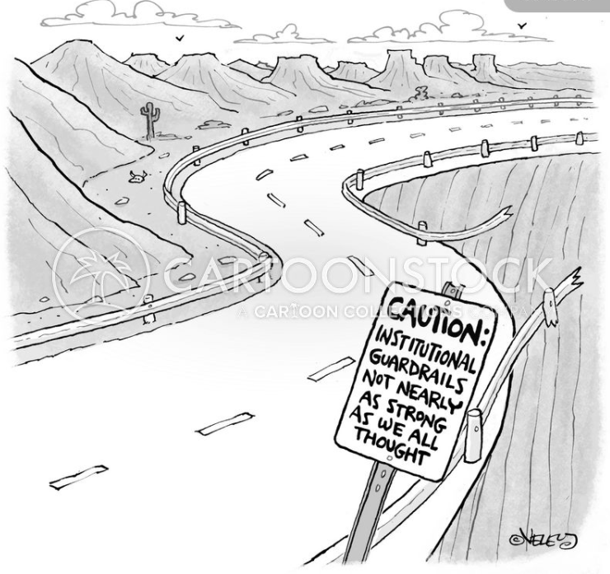
Guardrails Are Core to Our Product
Guardrails are critical to ensure MemorAI does NOT answer the questions it does not have context about.
Notes:
AJIT:
For any software product, building guardrails is critical for intentional and optimum customer experience. Its easy to miss out on this especially in earlier versions of the product and it can quickly become a slippery slope and make the product fall off the cliff.
Our GPT-3 model at the core of the product will always answer any question given its pretraining, whether or not MemorAI has any information about the person. That's our slippery slope for which we need to build guarails..
For MemorAI, we are giving it a thorough consideration and are experimenting different models and their effectiveness in establishing guardrails that will allow only relevant questions be answered by MemorAI.
In a nutshell, these guardrails are core to our product.

Slide 23
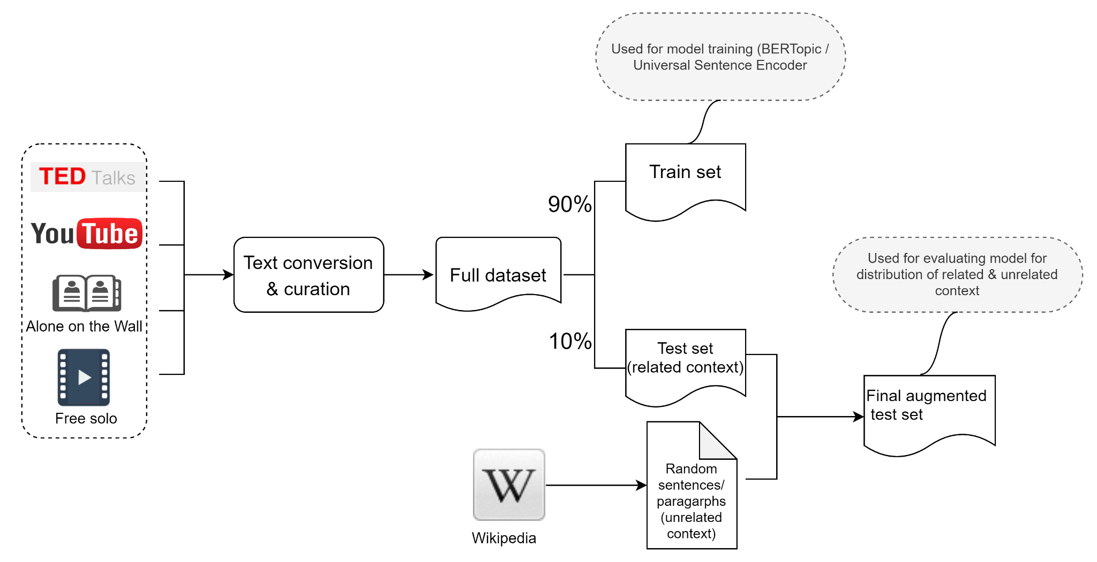
Guardrails Experiment: Dataset Preparation
Notes:
AJIT:
We conducted an experiment for our guardrails.
Our hypothesis was that the sentences pulled from a related context will have high similarity scores compared to the unrelated random sentences.
To validate this, we started with the data preparation. We created a text dataset about Alex Hannold built from various sources. We randomly picked 10% sentences from that as our test set. This is the related context with our train set. We then augmented the test dataset with random sentences pulled from Wikipedia to represent unrelated context with our training data.
Again, our hypothesis was that the the similarity scores for the related sentences will be higher (closer to 1) and for the unrelated sentences will be on the lower side (closer to 0). So much so that we can distinguish between these 2 similarity distributions.
We are using the Kolmogorov-Smirnov test (KS test) to validate our hypothesis that the distributions of related and unrelated context are different.

Slide 24
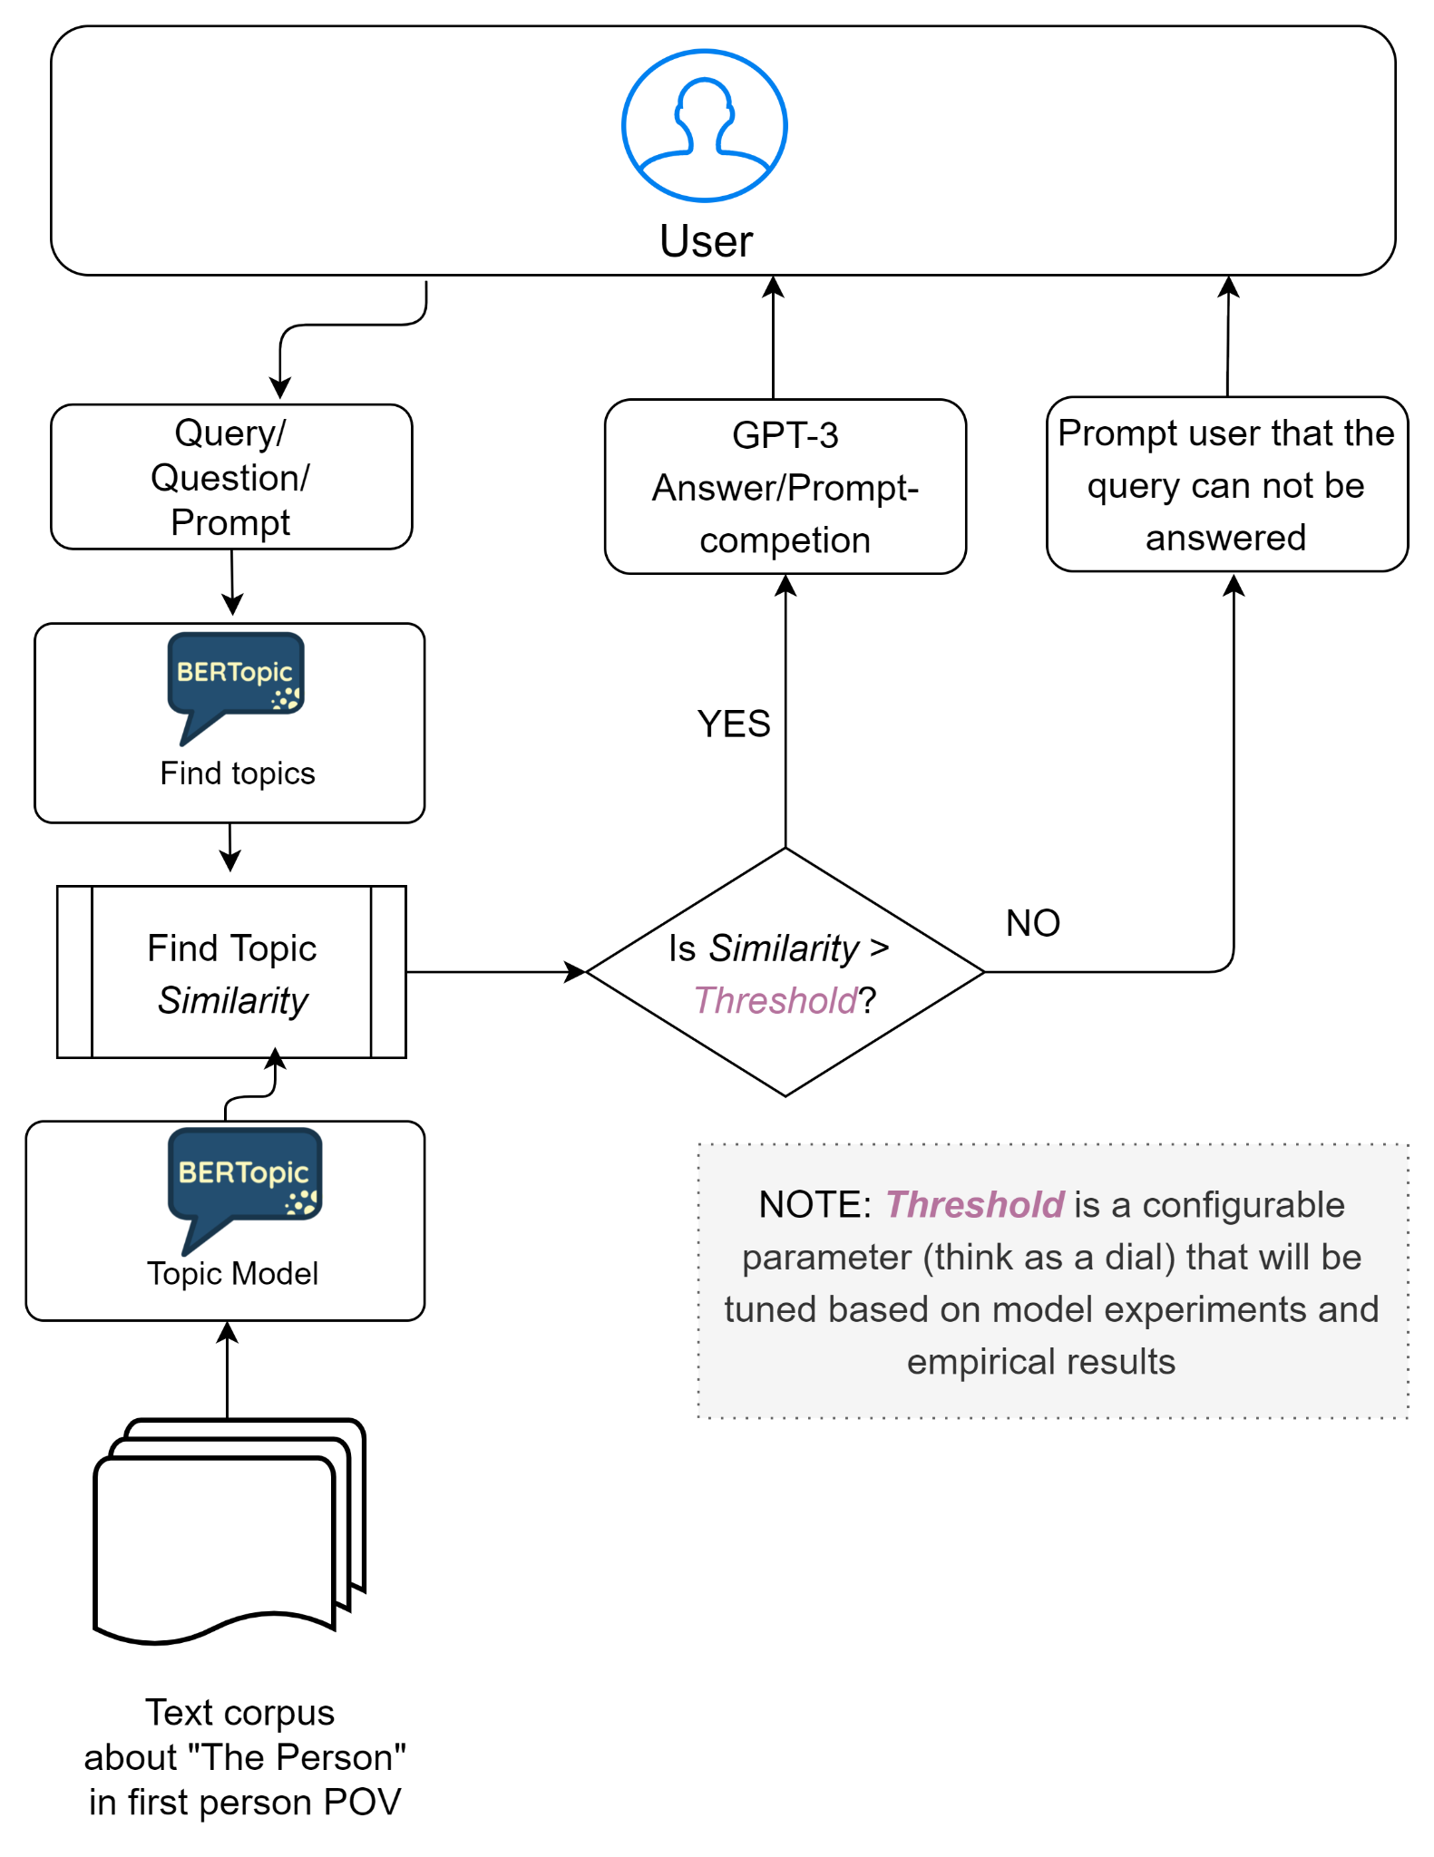
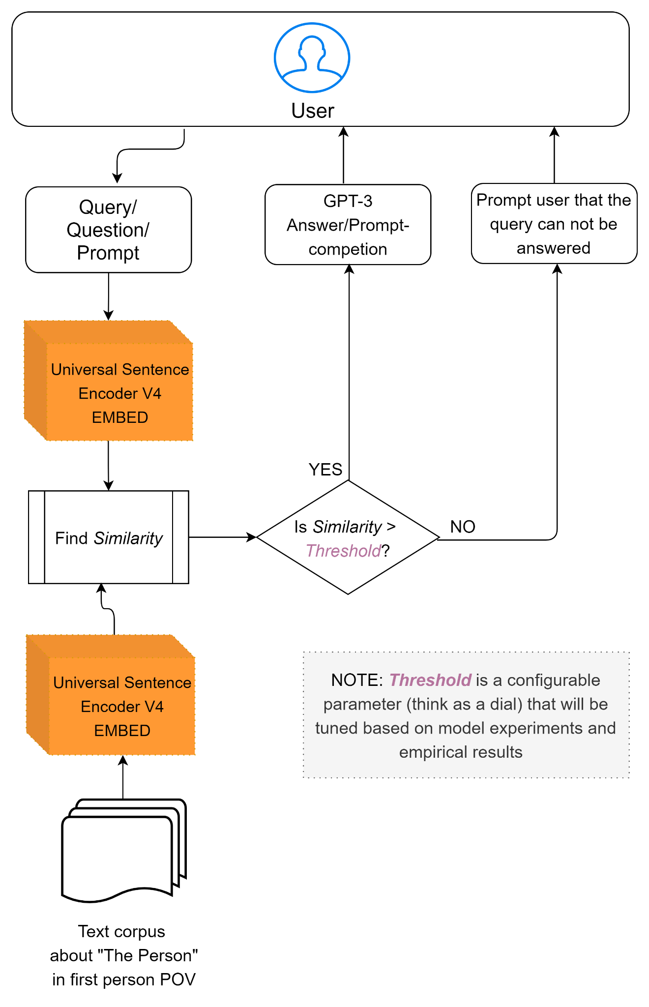
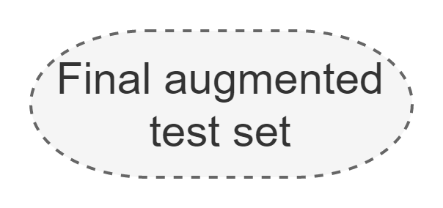
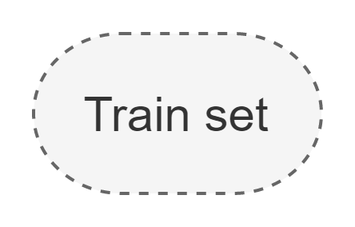
Guardrails Experiment: BERTopic vs USE4
Notes:
AJIT:
We picked up a couple of top models that are relevant for the task: BERTopic and Universal Sentence Encoder.
BERTopic setup is shown here on the left side of the slide. The model is trained on the train set we created to identify topics. The test set was fed through the model to find topic similarity scores.
In reality, the trained model will be available for the MemorAI application and the user query will be fed to the model to find the similarity score with train data. MemorAI will answer the query only if the similarity is greater than the threshold. Threshold will be set to a value derived from experiments and empirical results and will remain a configurable parameter for the application.
Universal Sentence Encoder setup is shown on the right side of the slide. The train set is encoded to generate sentence embeddings which are used to find similarity scores for the sentence embeddings for the test set.
We will look at the results on the next slide.

Slide 25
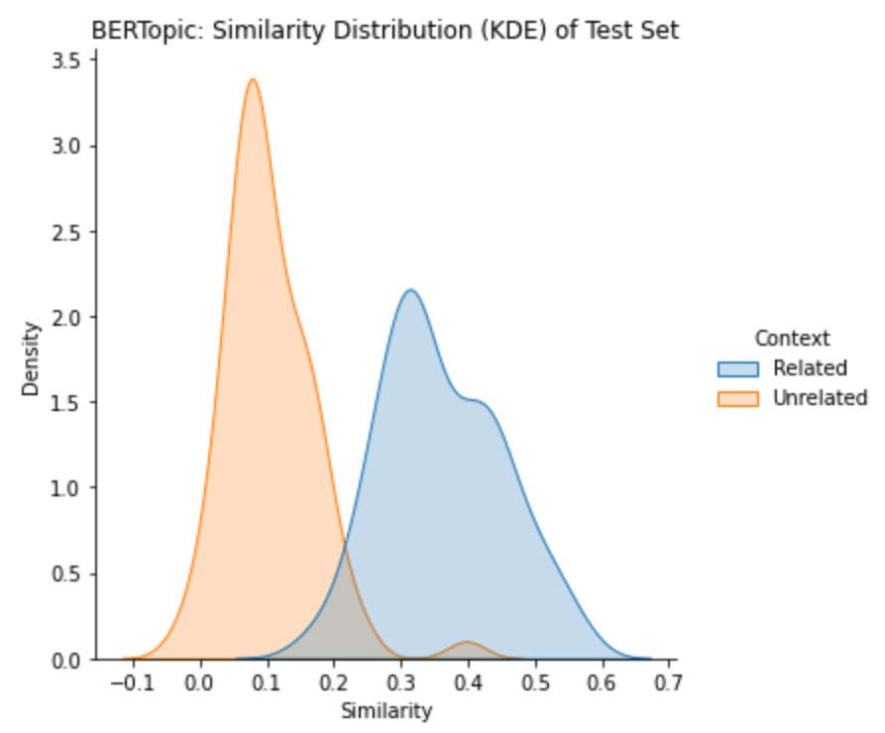
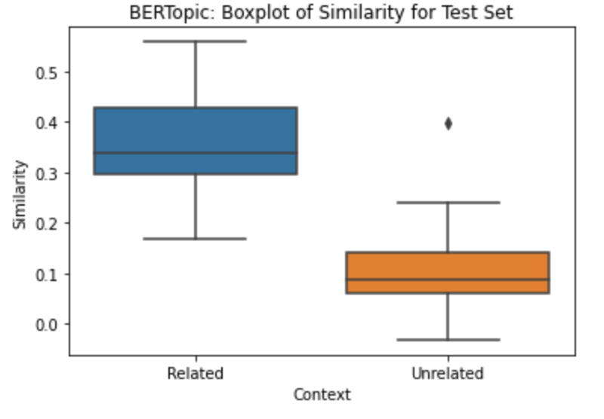

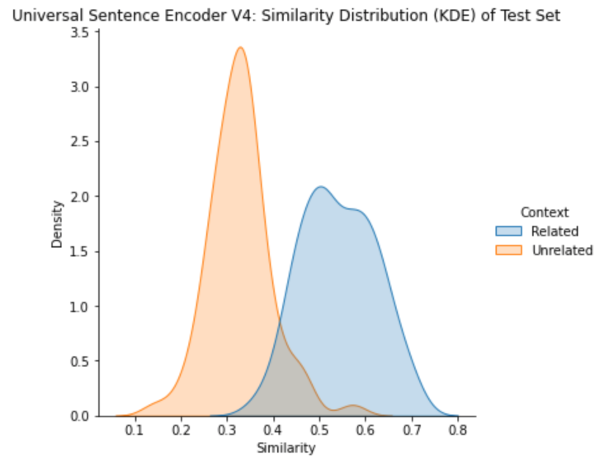
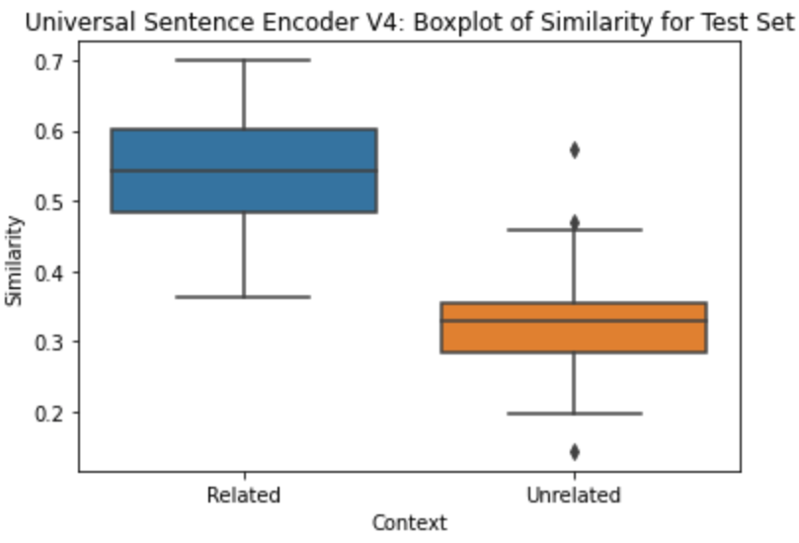
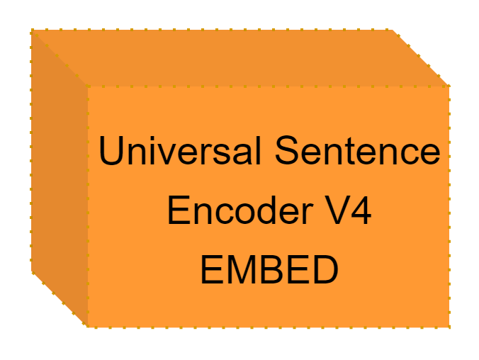
Guardrails: Experiment Results
KS Statistic = 0.94
P-value = 8.71e-35
KS Statistic = 0.88
P-value = 1.80e-29
Notes:
Ajit
This slide is horizontally divided in 2 parts. The top part is for the BERTopic results and the bottom part is for the Universal Sentence Encoder results.
We see that the p-value for the KS test for both models is almost 0 which means that the similarity distributions for related and unrelated sentences are different. We notice that the distributions have less overlap with BERTopic model and that is the model we are choosing to implement our guardrails for the V1 of our MVP.
Next, we want to experiment with the similarity threshold for the BERTopic model. For our purposes, precision and specificity are important metrics to really avoid answering questions that MemorAI should not answer. Hence, in next few days, we will experiment with various threshold values to select one which gives us optimum precision and specificity.
Just want to call out that, based on guidance from David, we would like to explore the use of reinforcement learning or GANs for NLP for implementing the guardrails. However, that will be for the V2 of our MVP.

Slide 26
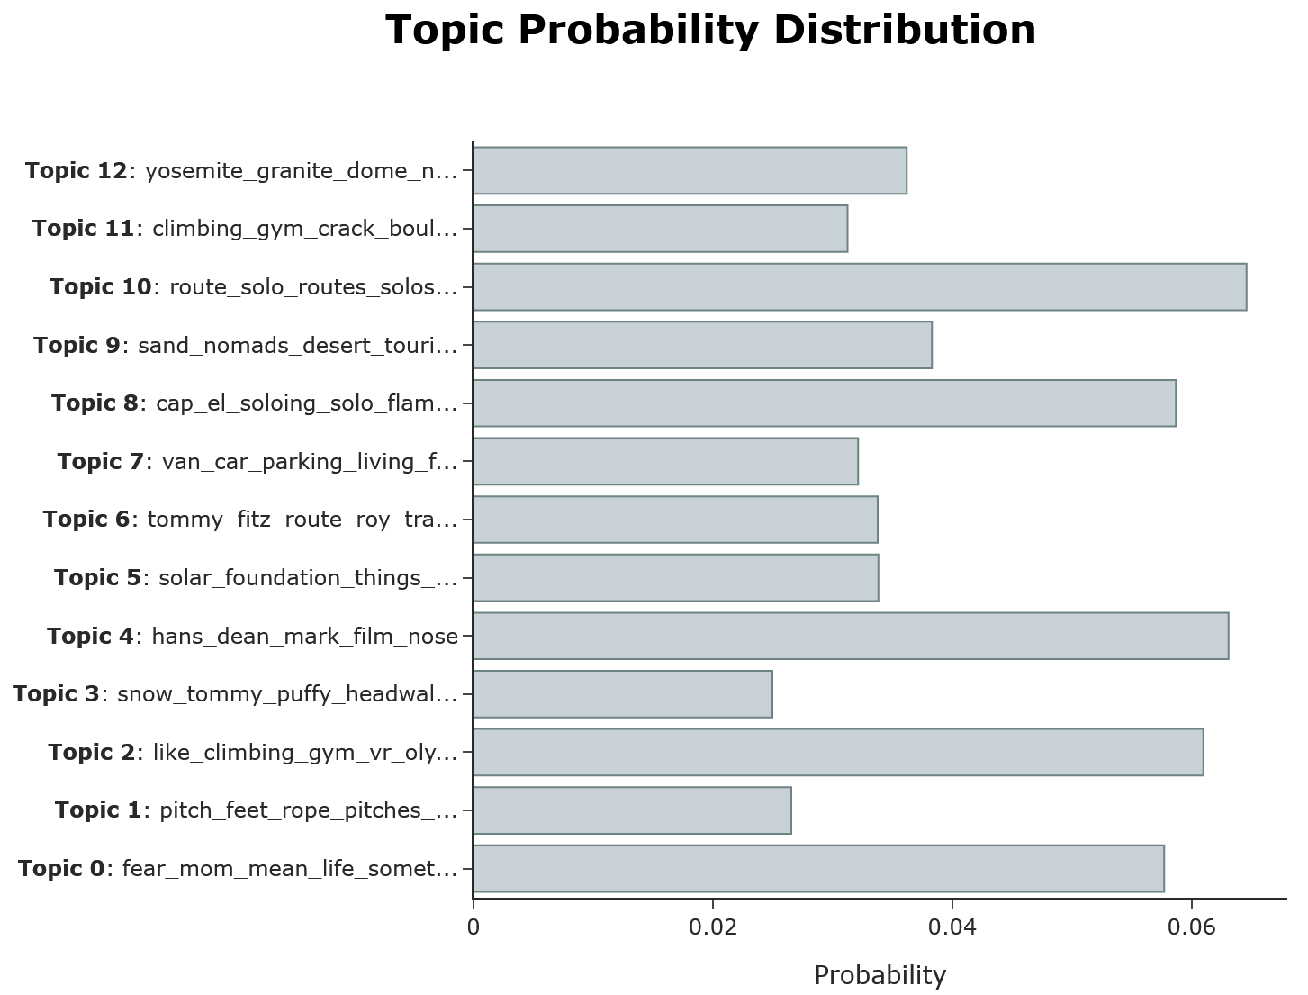
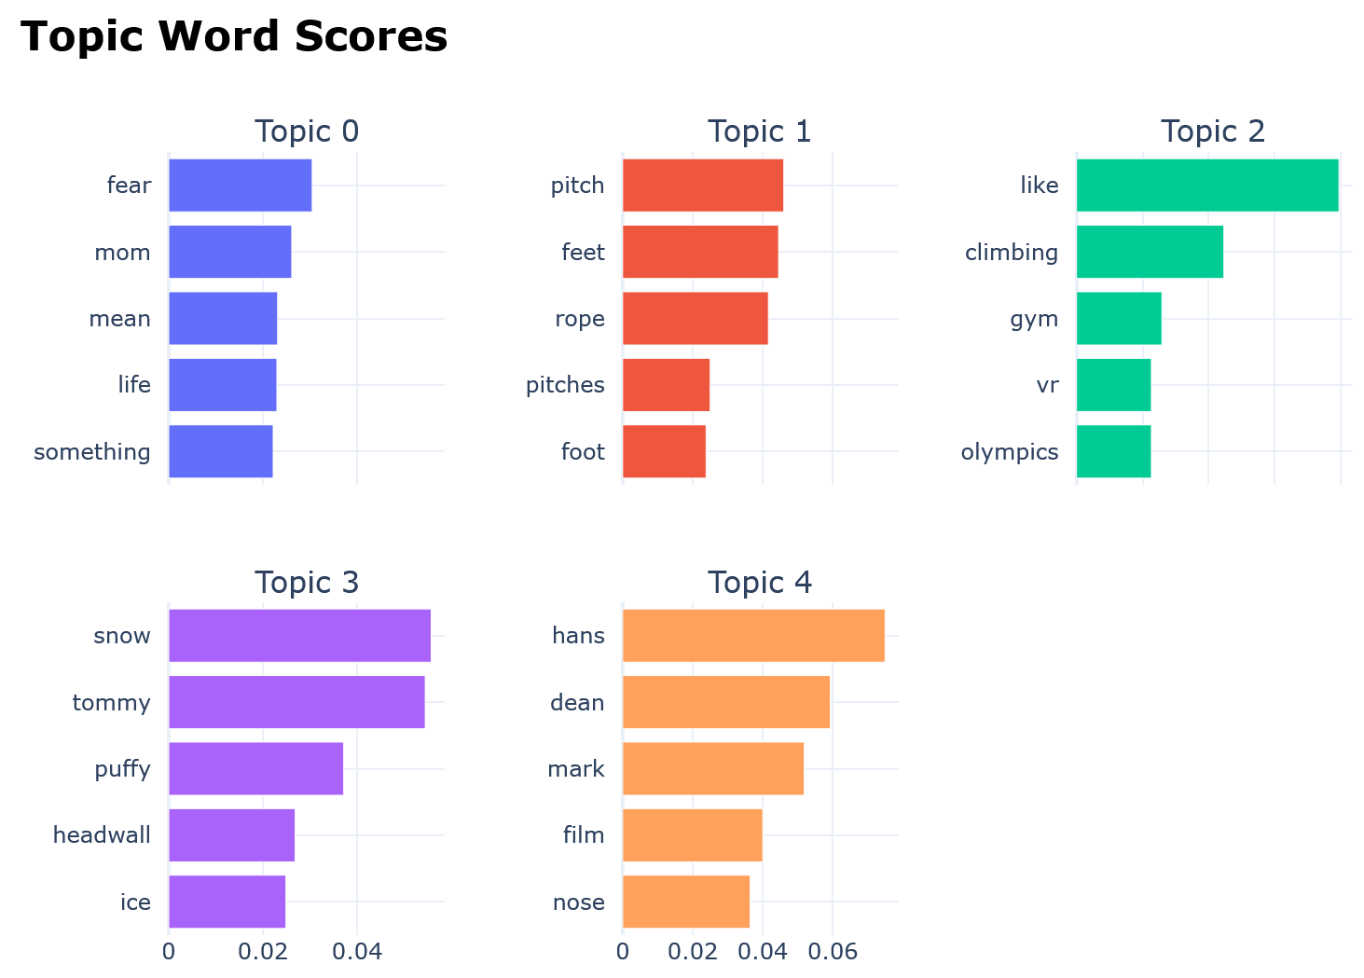
BERTopic Visualization
Notes:
AJIT:
Here is a visualization of the extracted topics and related top scoring words from the BERTopic model.
Next, Tim will walk us through the evaluation framework for our product.

Slide 27
Evaluation

Slide 28
Evaluation Framework
Evaluated by 2 NLP Models
Evaluated by Human
 | Fluency | Semantic | Narrative | Ethics
MFT - Minimum Functionality Test
DIR - Directional Expectation |  |  | n/a | n/a
INV - Invariance Test |  |  | n/a | n/a
Notes:
This is the full view of our evaluation framework.

Slide 29
Evaluation Framework
Evaluated by 2 NLP Models
Evaluated by Human
 | Fluency | Semantic | Narrative | Ethics
MFT - Minimum Functionality Test
DIR - Directional Expectation |  |  | n/a | n/a
INV - Invariance Test |  |  | n/a | n/a
Notes:
Let’s first focus on the 4 columns.
Fluency and Semantic will be measured by two different NLP models.
Nattive and Ethics are evaluated by human.

Slide 30
Fluency Evaluation
Model: Salesken from Hugging Face
Dataset: Query-wellformedness Dataset, Google
25,100 queries from the Paralex corpus (Fader et al., 2013) annotated with human ratings of whether they are well-formed natural language questions.
Notes:
So for Fluency Evaluation, we use a model trained on a dataset from Google with human ratings on how well a sentence is formed. The input of the model is one or multiple sentences. The output is a score of fluency which includes both grammars and punctuation.

Slide 31
Semantic Evaluation
Model
sBERT with DistilRoBERTa
Dataset
STSB (Semantic Textual Similarity) Benchmark
Notes:
In terms of Semantic Evaluation, we use SentenceBert and a dataset called Semantic Textual Similarity. This model will allow us to produce a similarity score between two groups of sentences.

Slide 32
Narrative & Ethics
Narrative
Does the model response feel like how the person would respond? 0-10
Ethics
Do you have any ethical concern with the experience? 0-10
Notes:
Narrative and ethics will be evaluated by human using a scale of 1 to 10..

Slide 33
Evaluation Framework
Evaluated by 2 NLP Models
Evaluated by Human
 | Fluency | Semantic | Narrative | Ethics
MFT - Minimum Functionality Test
DIR - Directional Expectation |  |  | n/a | n/a
INV - Invariance Test |  |  | n/a | n/a
CheckList*
Notes:
On top of the four testing verticals, each test example will be evaluated on three different variations. This is a framework we borrow from the paper CheckList. We will not go into the technical details but you can think of them as three different variations of exactly the same sentence. And we are just testing if our model can understand the same sentence told in 3 different ways.

Slide 34
Demo memor-ai.com
Notes:
Alice: recorded & live

Slide 35
Roadmap
Refine model
Maximize model performance, compare results with other models
Finetine guardrails
BERTopic - Similarity thresholding & analysis of precision & specificity for various thresholds
Explore NLP GANs and Reinforcement Learning with David
Evaluation
Curate test set
Execute framework
Notes:
We will continue to explore and finetune the model, our guardrails, and possibly working with David to try

Slide 36
Acknowledgement
Colorado Reed
David Steiner
Gurdit Chahal
Joyce Shen
Robert Louka

Slide 37
Appendix

Slide 38
Test Types (by CheckList*)
CheckList proposes three test types for NLP models.
MFT: Minimal Functional Test
Check model behaviors within its trained capability.
Example:
Why did you free solo Half Dome?
DIR: Directional Expectation
Extend input queries without changing intents. Then, observe shifts in the model’s predictions.
Examples:
Why did you free solo Half Dome?
Why did you free solo Half Dome in the Yosemite National Park?
Why did you free solo Half Dome in the Yosemite National Park? It was amazing.
INV: Invariance Test
Perturb input queries without changing intents (e.g. NER, synonyms, etc.). Then, observe shifts in the model’s predictions.
Examples:
Why did you free solo Half Dome?
Why did you free solo climb Half Dome?
Why did you climb Half Dome without a rope?
* Beyond Accuracy: Behavioral Testing of NLP models with CheckList ( https://arxiv.org/abs/2005.04118 )
Notes:
We will not get into the details on three three levels

Slide 39
References
Model:
GPT-3 Language Models are Few Shot Learners
https://arxiv.org/abs/2005.14165
OpenAI GPT-3 API documentation
https://beta.openai.com/docs/engines
Exploring GPT-3 book
https://learning.oreilly.com/library/view/exploring-gpt-3/9781800563193/cover.xhtml
Guardrails:
BERTopic implementation
https://github.com/MaartenGr/BERTopic
Universal Sentence Encoder
https://tfhub.dev/google/universal-sentence-encoder/4
Evaluation:
Beyond Accuracy: Behavioral Testing of NLP models with CheckList https://arxiv.org/abs/2005.04118
Query-wellformedness Dataset https://github.com/google-research-datasets/query-wellformedness

Slide 40
References
Evaluation cont:
Identifying Well-formed Natural Language Questions https://arxiv.org/abs/1808.09419
Salesken Wellformedness https://huggingface.co/salesken/query_wellformedness_score
Sentence BERT https://arxiv.org/abs/1908.10084
SentenceBERT — Semantically Meaningful Sentence Embeddings the Right Way https://medium.com/dair-ai/tl-dr-sentencebert-8dec326daf4e
Quora: Semantic Question Matching with Deep Learning https://quoraengineering.quora.com/Semantic-Question-Matching-with-Deep-Learning
STSbenchmark https://ixa2.si.ehu.eus/stswiki/index.php/STSbenchmark
Semantic Textual Similarity on STS Benchmark Leaderboard https://paperswithcode.com/sota/semantic-textual-similarity-on-sts-benchmark
BERT, RoBERTa, DistilBERT, XLNet — which one to use? https://towardsdatascience.com/bert-roberta-distilbert-xlnet-which-one-to-use-3d5ab82ba5f8
MemorAI Model Evaluation Notebook https://tinyurl.com/yevztjcn

Slide 41
Remove

Slide 42

A son who never had a chance to know his father...
Notes:
Dr. Mallett is a theoretical physics professor. He wants to build a time machine because he lost his father when he was 10, and he never really had a chance to get to know his father.

Slide 43




1990
2021
Notes:
So we can’t travel back in time, but we can travel forward through time.

Slide 44
Contents with First Person Views
Customers:
Early parent? Uncertainty ahead.
Extreme sport athletes.
Conrad Anker
Public figure
Kobe Bryant
Average People
Tim, Robert
What is the problem we are solving?
Too much contents.
No content.
How to find relevant content?
Why not search engine?
People can ask in addition to read. We want to validate that this experience complements reading.
Why can’t you ask friends and family?
It’s not their story
MVP is trying to validate:
Building Model
Can we build a convincing language model based on limited contents?
How much data do we need?
Alex vs. Robert vs. Erin
Asking complements reading
What if: We have a way to capture and preserve the thoughts of a person?
So that people are able to not just read but also ask?
Blogs
Books
Public
Public Interviews
Speeches
MemorAI Q&As
Private Contents (Diaries, Private Blogs, etc.)
Notes:
Social Media? Let’s not talk about it. (Not much depth)

Slide 45
Our products
Our product uses guardrails to make sure model input/output is within scope
Consult a therapy professional before using product
Offensive Content
Ethics : Truth/False
Privacy
Notes:
Ajit

Slide 46
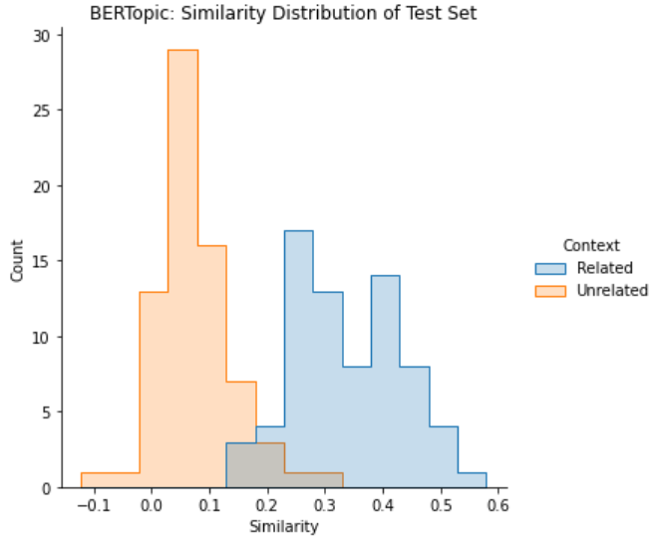
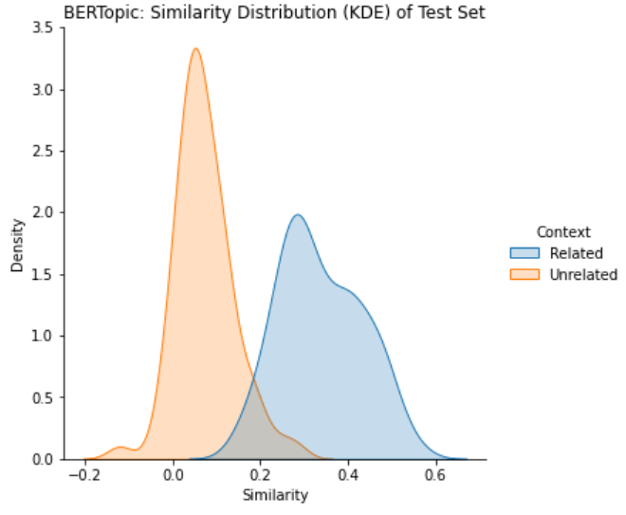
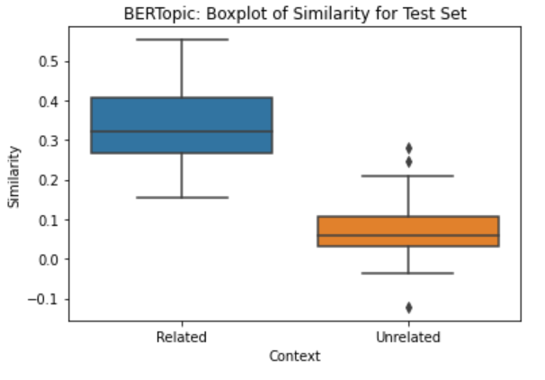
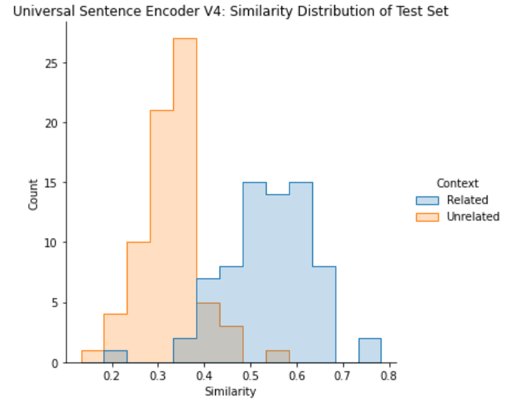
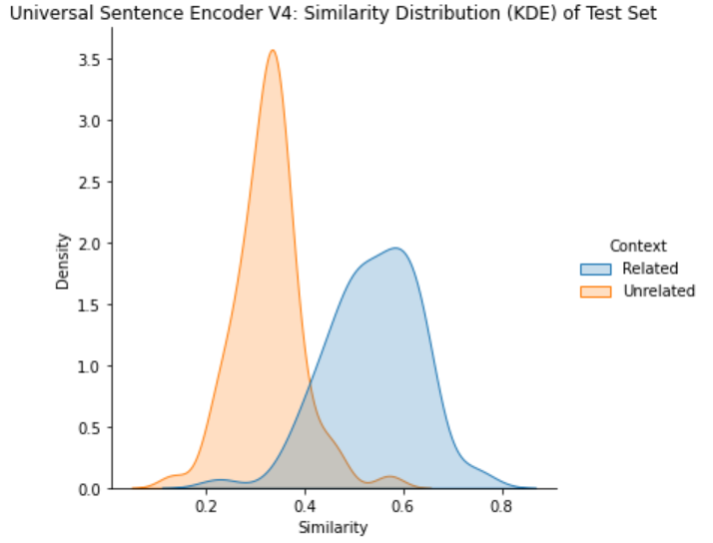
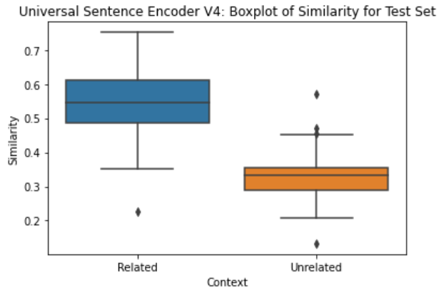
Guardrails: Results from the Experiment
KS Statistic = 0.92
P-value = 1.51e-32
KS Statistic = 0.84
P-value = 1.26e-26
Notes:
Ajit

Slide 47
Bad Sources of Training Set
Social Media Contents Problem: First person, but superficial
Friends & Family
Problem: Quality contents, but not first-person.
Notes:
What we don’t take though, are social media contents, because we want the contents to be authentic, detailed, and in-depth. We don’t believe social media shows who a person truly is.
Also, we prefer not to take stories from friends & family. We want first-person first-hand contents. We believe that stories from a person is the best way to tell who he or she is.

Slide 48
Data Science: Challenges
Data Collection - Cleaning - Preparation
Input and output monitoring
Tracking stats
Ethics
False Information / Misrepresentation
Emotional Impact: Are we building something to prevent people from moving on (e.g. wife chat bot)?
User Privacy
Notes:
Alice
Transcript are not always accurate, need manual review for semantics, making each data point a comprehensible and truthful to what the person actually said is time consuming
GPT3 is bias along the dimensions of gender, race and religions.

Slide 49
Agenda timetable
What | Who | How much time
Product | Tim | 3 min
Model & Pipeline | Alice | 3 min
Guardrails | Ajit | 3 min
Evaluation | Tim | 2 min
Demo | Alice | 2 min
 |  | Total: 13 min

Slide 50
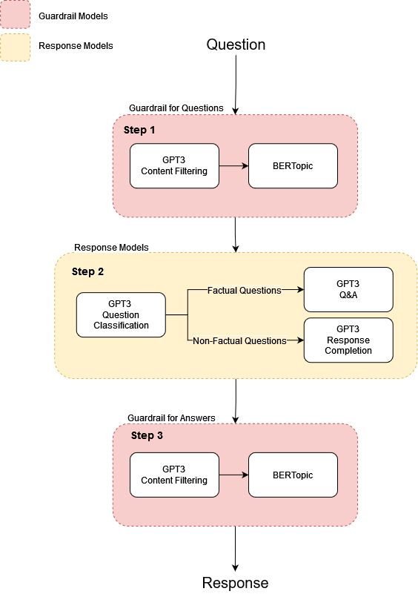
Inference Pipeline
Notes:
Here is what happens during inference time, Sarah’s question is the input, the model’s response is the output.
There are three steps from input to output. In Step 1, the question goes through our guardrail models to ensure that the question can be answered, if it can be answered, then the question enters Step 2, our Classification model will classify whether a question is a factual or a nonfactual question and use the appropriate model to respond (fact questions are answered by our Q&A model, non-factual questions such as “why do you love climbing?” are answered by our Completion model) I will go into the model details later in the presentation.
Finally in Step 3, the response is evaluated by the same guardrail system to ensure that it’s appropriate and relevant to our training data before returning the output to Sarah. Should any of these step fails, the model will politely decline to respond.

Slide 51

Guardrails Are Core to Our Product
Guardrails are critical to ensure MemorAI does NOT answer the questions it does not have context about.
Precision & Specificity are the metrics we optimized for the guardrail system
BERTopic vs. Universal Sentence Encoder v4
Notes:
Ajit:
For any software product, building guardrails is critical for intentional and optimum customer experience.
Our GPT-3 Q&A and Generative models at the core of the product will always answer any question given its pretraining, whether or not MemorAI has any information about the person. That's our slippery slope for which we need to build guarails.
For MemorAI, we are giving it a thorough consideration and have experimented with different models and their effectiveness in establishing guardrails that will allow only relevant questions be answered by MemorAI.
Given we have to minimize False Positives, the evaluation metrics of our choice are precision and specificity.

Slide 52
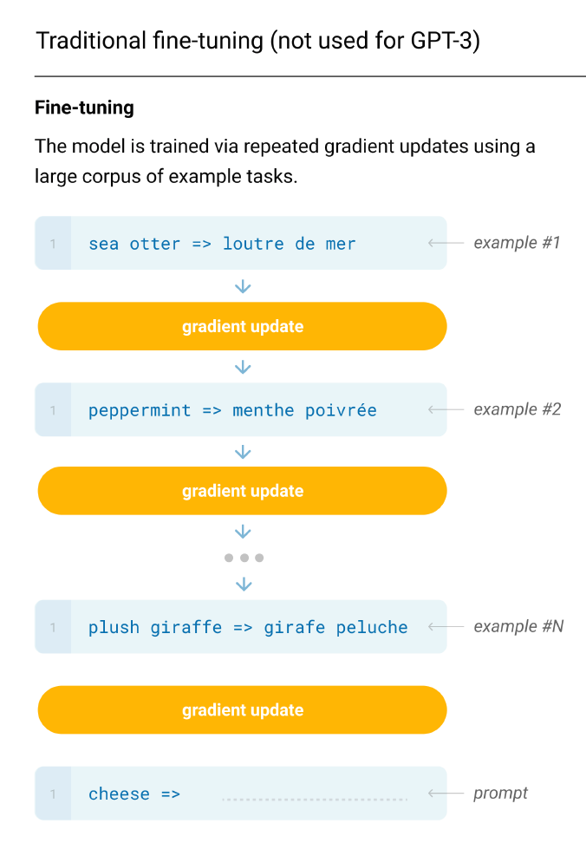
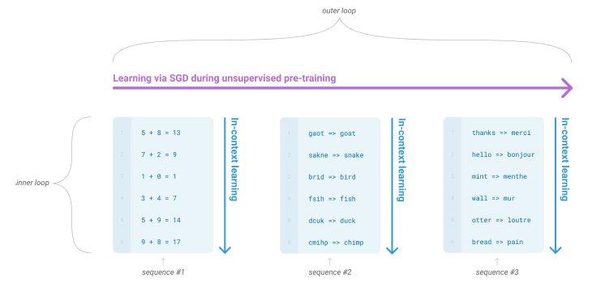
Language Model: GPT3
For our Classification model: meta-learning (in-context learning)
vs.
Brown Tom et. al. Language Models are Few-Shot Learners. https://arxiv.org/abs/2005.14165.
Notes:
Alice:
Here we chose to work with the Generative Pre-Trained Transformer 3rd version developed by OpenAI. This is a language model that can do any nlp task out of the box without finetuning.
As opposed to traditional task-specific finetuning where the model is trained via repeated gradient updates using a large task-specific dataset, GPT3 can perform fewshot learning where given a task description and a few examples of the task, the model can perform the task without any gradient updates.
How is few shot possible without gradient updates? because of meta-learning, the model develops a broad set of skills and pattern recognition abilities at training time, and use these abilities at inference time to rapidly adapt to the desired task. And the larger the model, the more proficient it is at meta-learning.
You can think of meta-learning with GPT3 by as absorbing many skills and tasks within the 175 billions parameters of the model
Extra:
Similar to GPT2, GPT3 is a transformer and an autoregressive language model, it also has similar model architecture and predicts the next word in probabilistically. However, the main big difference is GPT3 is pre-trained on a massive dataset with 175 billion parameters whereas its predecessor GPT2 has 1.5 billion and smaller dataset.
You see that the graph on the top left showing the compute in petaflops as compared to BERT-based models and T5.
By definition, GPT3 is more performant than GPT2 on language-based tasks.
The model uses few-shot learning where its in-context learning involves showing many demonstrations as will fit into context window of 2048 instead of traditional fine-tuning on large datasets, there’s no gradient updates. This is possible because it has been pre-trained on a vast amount of data.
The bottom left graph is showing that as the model scales up, the performance between 3 different learning settings increase to the point of surpassing fined-tuned SOTA.
(for this Q&A task, the SOTA is a fine-tuned closed-book T5 and fine-tuned RAG open-domain)
Extra:
Some differences GPT2 (2019) vs GPT3 (2020)
They use the same architect with some modifications in the transformer layers.
GPT3 has 96 attention layers with 96 attention heads each layer, 128 dimensions each head, with 3.2M batch size.
However, GPT3 is more performant than GPT2 on language-based tasks including code generation, generate news articles, conservation, etc.
GPT3 is evaluated on over 2 dozens NLP datasets under 3 conditions/settings: few shot, one-shot and zero shot. One-shot and zero (one demonstration and no demonstration, only instruction in natural language is given)
These conditions involve no gradient updates as opposed to fine-tuning on each task with a dataset, here, gpt3 few shot works just as well by increasing numbers of demonstrations at inference time.

Slide 53
Language Model: OpenAI GPT3
Language Modeling: the task of predicting the next word probabilistically
sea
laptop
The cat is sitting by the ____
window
P(x^{(t+1)} | x⁽¹⁾, …, x^{(t)}) where x^{(t+1)}) in the vocabulary V = {w₁, …, w_{|V|}}
Notes:
Alice:
A language model is a probability distribution over sequences of words
Generating responses is doing sampling from a probability distribution, given this sentence, what would the next word be? And so on
You can think of a your phone suggesting you the next word as you text as a simple language model
Formally: given a sequence of words, x(1) up to x(t), a language model is something that computes the probability distribution of the next word, x(t+1)
x(t+1) can be any word w from a fixed vocabulary V
As opposed to traditional task-specific finetuning where the model is trained via repeated gradient updates using a large task-specific dataset, GPT3 can perform fewshot learning where given a task description and a few examples of the task, the model can perform the task without any gradient updates.
How is few shot possible without gradient updates? because of meta-learning, the model develops a broad set of skills and pattern recognition abilities at training time, and use these abilities at inference time to rapidly adapt to the desired task. And the larger the model, the more proficient it is at meta-learning.
You can think of meta-learning with GPT3 by as absorbing many skills and tasks within the 175 billions parameters of the model
Extra:
Similar to GPT2, GPT3 is a transformer and an autoregressive language model, it also has similar model architecture and predicts the next word in probabilistically. However, the main big difference is GPT3 is pre-trained on a massive dataset with 175 billion parameters whereas its predecessor GPT2 has 1.5 billion and smaller dataset.
You see that the graph on the top left showing the compute in petaflops as compared to BERT-based models and T5.
By definition, GPT3 is more performant than GPT2 on language-based tasks.
The model uses few-shot learning where its in-context learning involves showing many demonstrations as will fit into context window of 2048 instead of traditional fine-tuning on large datasets, there’s no gradient updates. This is possible because it has been pre-trained on a vast amount of data.
The bottom left graph is showing that as the model scales up, the performance between 3 different learning settings increase to the point of surpassing fined-tuned SOTA.
(for this Q&A task, the SOTA is a fine-tuned closed-book T5 and fine-tuned RAG open-domain)
Extra:
Some differences GPT2 (2019) vs GPT3 (2020)
They use the same architect with some modifications in the transformer layers.
GPT3 has 96 attention layers with 96 attention heads each layer, 128 dimensions each head, with 3.2M batch size.
However, GPT3 is more performant than GPT2 on language-based tasks including code generation, generate news articles, conservation, etc.
GPT3 is evaluated on over 2 dozens NLP datasets under 3 conditions/settings: few shot, one-shot and zero shot. One-shot and zero (one demonstration and no demonstration, only instruction in natural language is given)
These conditions involve no gradient updates as opposed to fine-tuning on each task with a dataset, here, gpt3 few shot works just as well by increasing numbers of demonstrations at inference time.

